Slide 1


Introduction to Transcriptomics
Transcriptomics is the comprehensive study of the complete set of RNA transcripts, including mRNA, rRNA, tRNA, and other non-coding RNAs, produced by the genome at a specific developmental stage or under particular physiological conditions.

Slide 2

What is the Transcriptome?
The transcriptome refers to the complete set of RNA transcripts expressed in a cell, tissue, or organism at a given time. It includes all types of RNA, such as messenger RNA (mRNA), ribosomal RNA (rRNA), transfer RNA (tRNA), and non-coding RNAs (e.g., microRNAs, long non-coding RNAs).
The transcriptome is dynamic and can vary depending on the cell type, developmental stage, physiological conditions, or disease state. Understanding the transcriptome is crucial for studying gene expression, regulatory mechanisms, and identifying potential biomarkers or therapeutic targets.

Slide 3
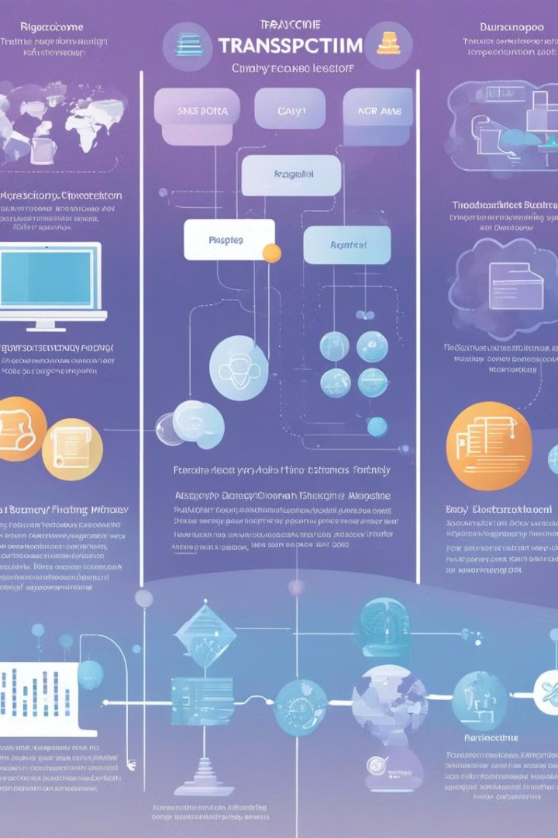
Techniques for Transcriptome Analysis
RNA Sequencing (RNA-Seq): High-throughput sequencing of the entire transcriptome, allowing for comprehensive analysis of gene expression levels, alternative splicing, and identification of novel transcripts.
Microarray Analysis: Hybridization-based technique for measuring the expression of thousands of genes in parallel, though limited to known sequences and less sensitive than RNA-Seq.
Real-Time Quantitative PCR (RT-qPCR): Highly sensitive and accurate method for quantifying the expression of specific genes, often used to validate findings from high-throughput techniques.

Slide 4
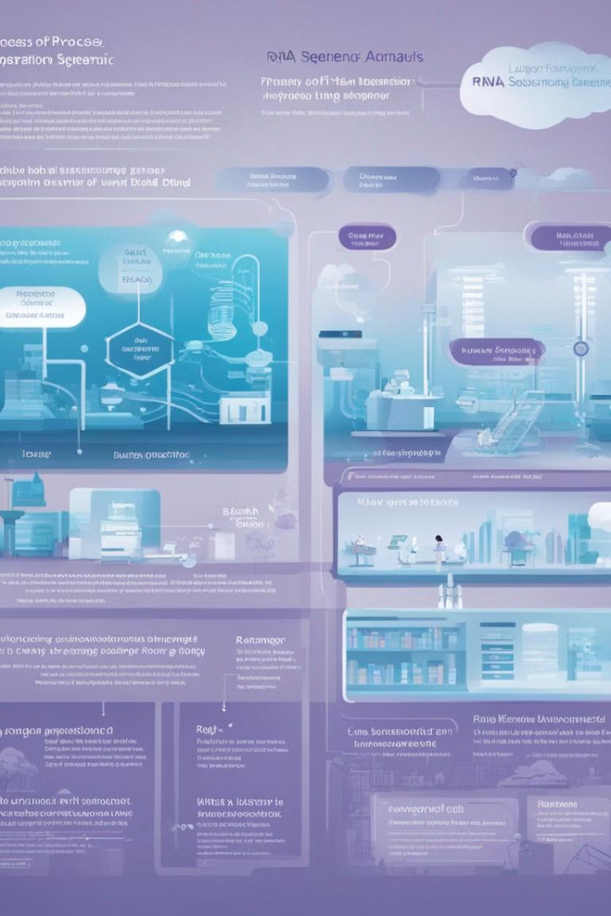
Principles of RNA-sequencing (RNA-seq)
RNA-seq is a powerful technique that uses next-generation sequencing to profile the entire transcriptome of a cell or tissue. It involves extracting RNA, converting it to cDNA, fragmenting the cDNA, and then sequencing the fragments to obtain millions of short reads.
These reads are then computationally aligned to a reference genome or transcriptome, allowing for the quantification of gene expression levels and the identification of novel transcripts, alternative splicing events, and RNA modifications.

Slide 5

Advantages of RNA-seq over Microarrays
RNA-seq offers several advantages over traditional microarray technology for transcriptome analysis:
Higher resolution and sensitivity to detect low abundance transcripts
Ability to identify novel transcripts and splice variants not represented on microarray chips
Provides quantitative measurements of gene expression levels across a wider dynamic range
Requires less input material and has lower background noise

Slide 6

Experimental Design for RNA-seq
Sample Selection
1
Carefully choose biological samples that represent the conditions you want to study, ensuring biological replicates for statistical power.
2
RNA Extraction
Isolate high-quality RNA from your samples using optimized protocols to capture a comprehensive transcriptome profile.
Library Preparation
3
Construct sequencing libraries from the extracted RNA, using protocols that preserve strand information and transcript isoforms.

Slide 7
RNA-seq Data Processing and Analysis
Raw Data Processing
Alignment and Quantification
Normalization
Quality Control
Normalization methods are applied to account for differences in sequencing depth and other technical factors, enabling accurate comparisons of expression levels between samples.
Rigorous quality control checks are performed to assess the overall data quality, identify outliers, and ensure the reliability of the results.
RNA-seq data consists of millions of short sequencing reads. These reads must be preprocessed to remove low-quality and adapter sequences, ensuring high-quality data for downstream analysis.
The cleaned reads are then aligned to a reference genome or transcriptome, allowing the quantification of gene and transcript expression levels across samples.

Slide 8
Differential Gene Expression Analysis
1
Identifying Differentially Expressed Genes
2
Fold Change Calculation
The magnitude of differential expression is quantified by calculating the fold change, which represents the ratio of expression levels between the compared conditions.
Statistical methods are used to determine which genes are expressed at significantly different levels between conditions, such as treatment vs control or diseased vs healthy samples.
3
P-value and FDR Correction
4
Visualization and Interpretation
A p-value is calculated to assess the statistical significance of the observed differential expression, and False Discovery Rate (FDR) correction is applied to account for multiple testing.
Differentially expressed genes are often visualized using heatmaps, volcano plots, and other graphical representations to aid in the interpretation of the results.

Slide 9




Applications of Transcriptomics
Biological Research
Precision Medicine
Biotechnology
Evolutionary Studies
Transcriptomics provides insights into gene expression patterns, revealing fundamental biological processes and mechanisms.
Transcriptomic profiling can identify biomarkers for disease diagnosis, prognosis, and personalized treatment strategies.
Transcriptomics enables optimization of production processes in industries like biofuels, pharmaceuticals, and agriculture.
Comparative transcriptomics can shed light on the evolution of genes and gene expression across species.

Slide 10
Future directions in transcriptomics
Single-cell RNA-seq
1
Advances in single-cell sequencing technologies
Long-read sequencing
2
Improving transcriptome assembly and isoform detection
Multimodal omics
3
Integrating transcriptomics with other 'omics data
As transcriptomics continues to evolve, several exciting future directions are emerging. Single-cell RNA sequencing will enable a deeper understanding of cell-to-cell heterogeneity, while long-read sequencing techniques will improve transcript assembly and isoform detection. Additionally, the integration of transcriptomics with other 'omics data, such as proteomics and epigenomics, will provide a more comprehensive view of cellular processes.

